Slide 1
Intersection Concepts under Consideration
New Circle Road Improvement Project
Fayette County
KYTC Item No. 7-438

Slide 2
Introduction
This brief presentation will explain some of the intersection concepts the KY Transportation Cabinet project team is considering to improve safety and traffic operations for the New Circle Road Improvement Project

Slide 3
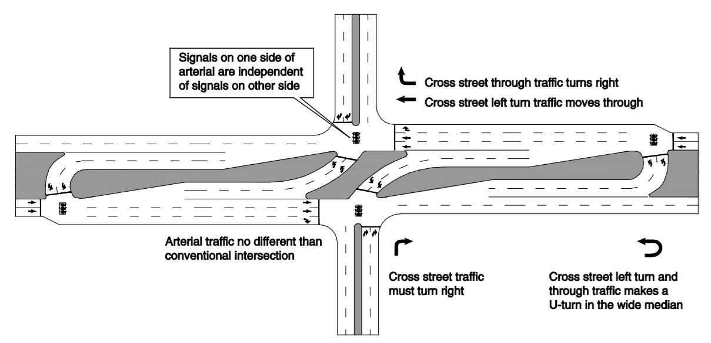
Restricted Crossing U-Turn (RCUT) Intersection
What is an RCUT?
An RCUT, sometimes referred to as a J-Turn, allows normal turning movements from the major route but allows only right turns from the minor approaches. Vehicles wishing to turn left must make a right turn and then a U-turn.
Benefits
Traffic: The traffic signal at the main intersection operates with just two signal phases.
Safety: All crashes are reduced by about 35% compared to a standard signalized intersection

Slide 4
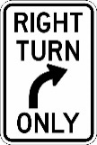
Restricted Crossing U-Turn (RCUT) Intersection
Traffic on New Circle can only access Woodhill & Life Ln. via right turn
U-turn
Pedestrians cross New Circle via tunnel system
Traffic on Woodhill & Life Ln. can only turn right

Slide 5
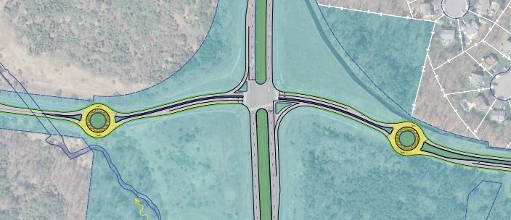
Bowtie Roundabout Intersection
What is a Bowtie Roundabout?
A Bowtie roundabout is an intersection where left-turn movements are completed at adjacent roundabouts on the side street.
Benefits
Safety: Reduces the number of conflict points, promotes lower speeds.
Traffic: There are no left turns at the main intersection, reducing stops and delay. Fewer traffic signal phases means less stopping time at the main intersection.
Left-Turn

Slide 6
Bowtie Roundabout
Pedestrians can cross New Circle via tunnel
Traffic on Liberty can turn right or continue through
Christian Rd.
U-turn
U-turn
Liberty Rd.
Creative Dr.
Traffic on New Circle can only turn right
Wilderness Rd.

Slide 7
Grade Separation
What is Grade Separation?
Removing an intersection by separating two roadways with an overpass.
No access to Woodhill or Life Ln. from New Circle
Life Ln.
Benefits
Pedestrians cross New Circle under the overpass
Woodhill Dr.
Safety: Removes conflict points at the intersection.
Traffic: Traffic does not stop (on both the main route and side street).

Slide 8
Intersection Options Under Consideration
Intersection | Conventional Widening | RCUT | Bowtie | Grade Separation
Woodhill Drive | X | X |  | X
Palumbo Drive | X | X
Young Drive | X | X
Liberty Road | X |  | X | X

